Slide 1
Chapter 3: Processes

Slide 2
Chapter 3: Processes
3.1 Process Concept
3.2 Process Scheduling
3.3 Operations on Processes
3.4 Inter-process Communication (IPC)
OBJECTIVES
To introduce the notion of a process -- a program in execution, which forms the basis of all computation
To describe the various features of processes, including scheduling, creation and termination, and communication
To learn about interprocess communication

Slide 3
3.1 Process Concept
Process – a program in execution; process execution must progress in sequential fashion
Program is passive entity stored on disk (executable file), process is active
  Program becomes process when executable file loaded into memory
Execution of program started via GUI mouse clicks, command line entry of its name, etc
One program can be several processes
  Consider multiple users executing the same program
  Example: If two users are running a word processor, two processes will be created.

Slide 4
3.1.1 Process Structure
A process is more than the program code, which is sometimes known as the text section.
It also includes the current activity:
  The value of the program counter
  The contents of the processor's registers.
It also includes the process stack, which contains temporary data (such as function parameters, return addresses, and local variables)
It also includes the data section, which contains global variables.
It may also include a heap, which is memory that is dynamically allocated during process run time.

Slide 5
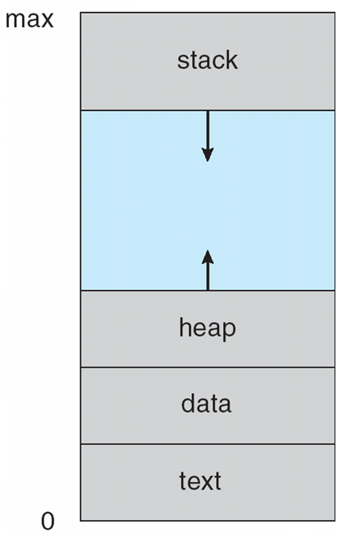
Process in Memory
Figure 3.1

Slide 6
Process States
Process states depict the current activity of a process.
When a process is executed,
  the process will change from one state to another;
  changes states after an event occurs.
Process State Models
Two-state Model
Five-state Model
A state transition diagram can tell what event causes a process to change states

Slide 7
Process with Two-State Model
  A process can be in one of the following states:
    Running
    Not-running
  State Transition Diagram
Dispatch
Enter
Not
Running
Exit
Running
Pause

Slide 8
Two-State Model : Queue Diagram
Queue
ENTER
Dispatch
CPU
EXIT
Pause

Slide 9

3.1.2 Process State (Five State Model)
As a process executes, it changes state
  new: The process is being created
  running: Instructions are being executed
  waiting: The process is waiting for some event to occur
  ready: The process is waiting to be assigned to a processor
  terminated: The process has finished execution
State Transition Diagram:
Figure 3.2 Diagram of process state

Slide 10
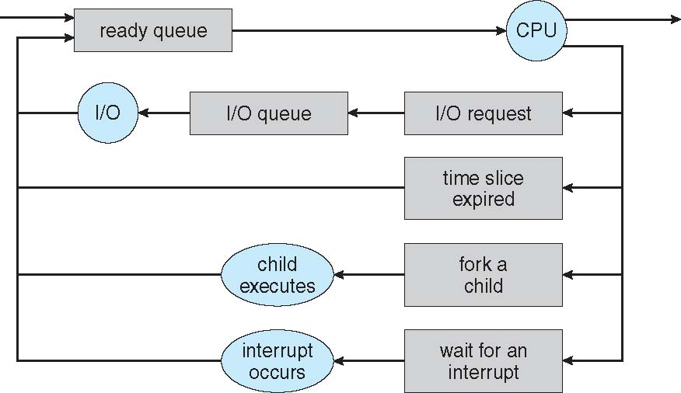
Five State Model: Queue Diagram
Queuing diagram represents queues, resources, flows
Figure 3.6 Queueing-diagram representation of process scheduling

Slide 11
Process Description
OS controls all the events that occur in a computer system.
Therefore some data structure is needed to keep track of this information
P1
P2
P3
Virtual
Memory
Computer
Resources
CPU
I/O
I/O
I/O
Memory
Allocated
Request

Slide 12
Information Table (cont…)
OS needs to keep track on the status of each process as well as the resources available in a computer system.
Done by keeping the information in tables as follows:
I/O Table
Memory Table
File Table
Process Table

Slide 13
Information Table (…cont)
Memory Tables
Process
Image
for
Process 1
Memory
Devices
I/O Tables
Files
Processes
File Tables
Process Tables
Process
Image
for
Process n
Process 1
.
.
Process n

Slide 14

3.1.3 Process Control Block (PCB)
Information associated with each process
(also called task control block)
Process state – running, waiting, etc
Program counter – location of instruction to next execute
CPU registers – contents of all process-centric registers
CPU scheduling information- priorities, scheduling queue pointers
Memory-management information – memory allocated to the process
Accounting information – CPU used, clock time elapsed since start, time limits
I/O status information – I/O devices allocated to process, list of open files
Figure 3.3

Slide 15
3.1.4 Threads
So far, process has a single thread of execution
Consider having multiple program counters per process
  Multiple locations can execute at once
    Multiple threads of control -> threads
Need storage for thread details, multiple program counters in PCB
Covered in the next chapter

Slide 16
3.2 Process Scheduling
Maximize CPU use
  Quickly switch processes onto CPU for time sharing
Process scheduler selects among available processes for next execution on CPU
Maintains scheduling queues of processes
  Job queue – set of all processes in the system
  Ready queue – set of all processes residing in main memory, ready and waiting to execute
  Device queues – set of processes waiting for an I/O device (Figure 3.5)
  Processes migrate among the various queues
A common representation of process scheduling is a queueing diagram. (Figure 3.6 in slides #11)

Slide 17
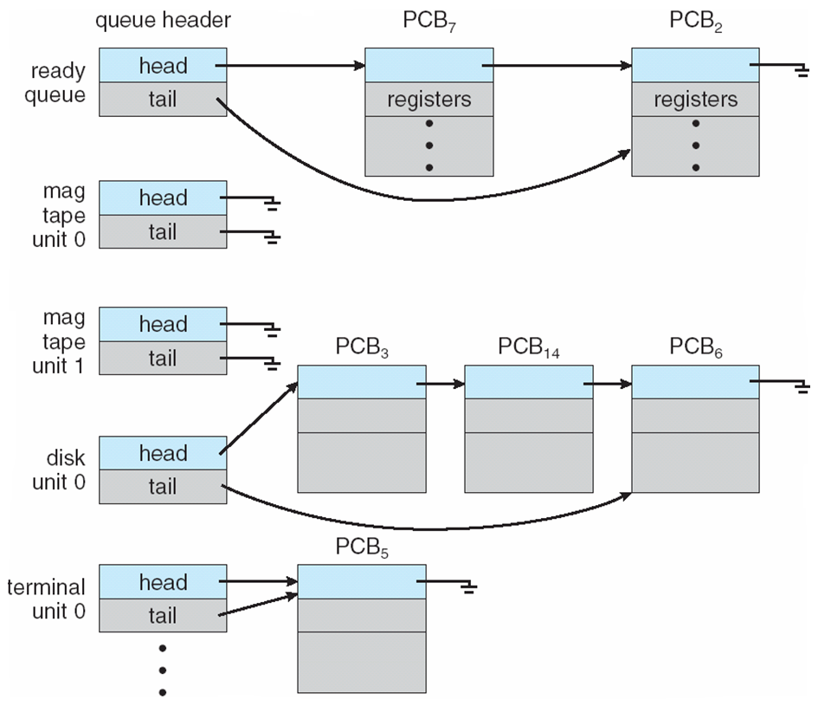
Ready Queue And Various I/O Device Queues
Figure 3.5

Slide 18
3.2.2 Schedulers
Short-term scheduler (or CPU scheduler) – selects which process should be executed next and allocates a CPU
  Sometimes the only scheduler in a system
  Short-term scheduler is invoked frequently (milliseconds) ⇒ (must be fast)
Long-term scheduler (or job scheduler) – selects which processes should be brought into the ready queue
  Long-term scheduler is invoked infrequently (seconds, minutes) ⇒ (may be slow)
  The long-term scheduler controls the degree of multiprogramming
Processes can be described as either:
  I/O-bound process – spends more time doing I/O than computations, many short CPU bursts
  CPU-bound process – spends more time doing computations; few very long CPU bursts
Long-term scheduler strives for good process mix

Slide 19
. . . Process Scheduler (cont’d)
Middle-level scheduler: third layer
Found in highly interactive environments
  Handles overloading
    Removes active jobs from memory
    Reduces degree of multiprogramming
  Results in faster job completion
Single-user environment
  No distinction between job and process scheduling
  One job active at a time
    Receives dedicated system resources for job duration

Slide 20
Multitasking in Mobile Systems
Some mobile systems (e.g., early version of iOS) allow only one process to run, others suspended
Starting with iOS 4, it provides for a
  Single foreground process – controlled via user interface
  Multiple background processes – in memory, running, but not on the display, and with limits
  Limits include single, short task, receiving notification of events, specific long-running tasks like audio playback
Android runs foreground and background, with fewer limits
  Background process uses a service to perform tasks
  Service can keep running even if background process is suspended
  Service has no user interface, small memory use

Slide 21
3.2.3 Context Switch
When CPU switches to another process, the system must save the state of the old process and load the saved state for the new process via a context switch
Context of a process represented in the PCB
Context-switch time is pure overhead; the system does no useful work while switching
  The more complex the OS and the PCB ➔ the longer the context switch
Time dependent on hardware support
  Some hardware provides multiple sets of registers per CPU ➔ multiple contexts loaded at once

Slide 22

CPU Switch From Process to Process
Figure 3.4

Slide 23
When to Switch a Process
Clock interrupt
  process has executed for the maximum allowable time slice
I/O interrupt
Memory fault
  memory address is in virtual memory so it must be brought into main memory
Trap
  error occurred
  may cause process to be moved to Exit state
Supervisor call
  such as file open

Slide 24
3.3 Operations on Processes
System must provide mechanisms for:
  process creation,
  process termination,
  and so on as detailed next

Slide 25
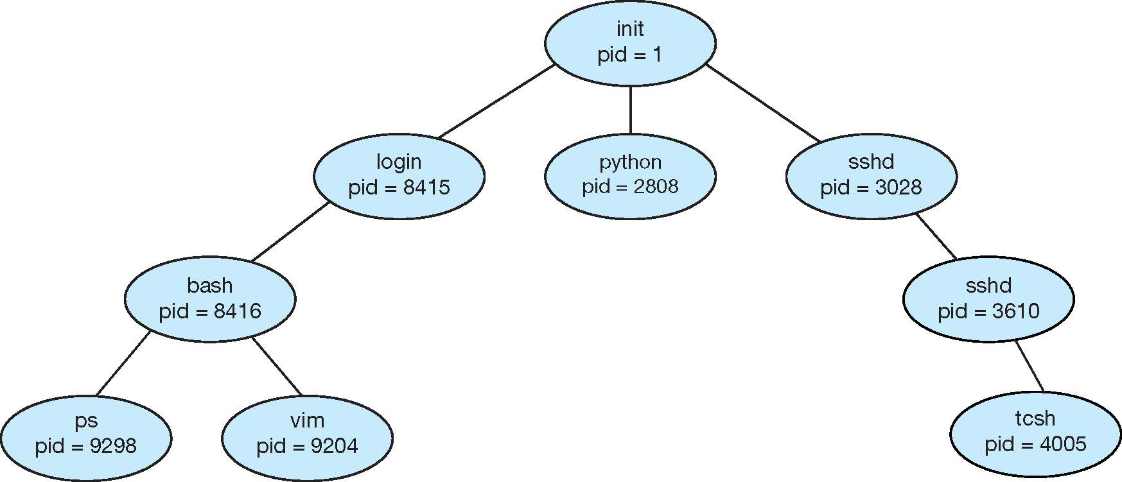
3.3.1 Process Creation
A process may create other processes.
Parent process create children processes, which, in turn create other processes, forming a tree of processes
Generally, a process is identified and managed via a process identifier (pid)
A Tree of Processes in UNIX

Slide 26
Process Creation (Cont.)
Resource sharing among parents and children options
  Parent and children share all resources
  Children share subset of parent’s resources
  Parent and child share no resources
Execution options
  Parent and children execute concurrently
  Parent waits until children terminate

Slide 27
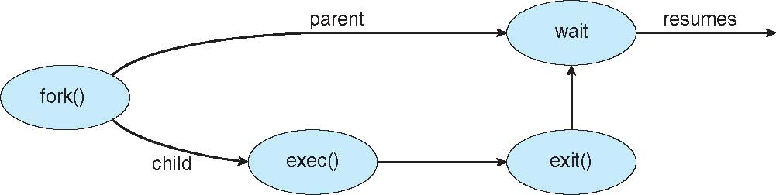
Process Creation (Cont.)
Address space
  A child is a duplicate of the parent address space.
  A child loads a program into the address space.
UNIX examples
  fork() system call creates new process
  exec() system call used after a fork()replaces the process’ memory space with a new program
Figure 3.10 Process creation using the fork() system call

Slide 28
C program to create a separate process in UNIX
int main()
{
pit.t pid;
/*fork a child process */
pid = fork();
if (pid < 0) { /* error occurred */
fprintf(stderr, “Fork Failed”);
return 1;
}
else if (pid == 0) { /*child process */
execlp(“/bin/ls”,”ls”,NULL);
}
else { /* parent process */
/* parent will wait for the child to complete */
wait(NULL);
printf(“Child Complete”);
}
return 0;
}
Figure 3.9

Slide 29
C Program Forking Separate Process
The C program illustrates how to create a new process UNIX.
After fork() there are two different processes running copies of the same program. The only difference is that the value of pid for the child process is zero, while that for the parent is an integer value greater than zero
The child process inherits privileges and scheduling attributes from the parent, as well certain resources, such as open files.
The child process then overlays its address space with the UNIX command “ls” (used to get a directory listing) using the execlp() (a version of the exec() system call).
The parent waits for the child process to complete with the wait() system call.
When the child process completes the parent process resumes from the call to wait(), where it completes using the exit() system call.

Slide 30
Creating a Separate Process via Windows API
int main(VOID)
{
STARTUPINFO si;
PROCESS_INFORMATION pi;
/* allocate memory */
ZeroMemory(&si, sizeof(si));
si.cb = sizeof(si);
ZeroMemory(&pi, sizeof(pi));
/* create child process */
if (!CreateProcess(NULL, /* use command line */
“C:\\WINDOWS\\system32\\mspaint.exe”,/* command */
NULL, /* don’t inherit process handle */
NULL, /* don’t inherit threat handle */
FALSE, /* disable handle inheritance */
0, /* no creation flags */
NULL, /* use parent’s environment block */
NULL, /* use parent’s existing directory */
&si,
&pi))
{
{
fprintf{stderr, “Create Process Failed”};
return -1;
}
/* parent will wait for the child to complete */
WaitForSingleObject(pi.hProcess, INFINITE);
printf(“Child Complete”);
/* close handles */
CloseHandle(pi.hProcess);
CloseHandle(pi.hThread);
}
Figure 3.11

Slide 31
3.3.2 Process Termination
A process terminates when it finishes executing its final statement and it asks the operating system to delete it by using the exit() system call.
  At that point, the process may return a status value (typically an integer) to its parent process (via the wait() system call.
  All the resources of the process are deallocated by the operating system.
A parent may terminate the execution of children processes using the abort() system call. Some reasons for doing so:
  Child has exceeded allocated resources
  Task assigned to child is no longer required
  The parent is exiting and the operating systems does not allow a child to continue if its parent terminates

Slide 32
Process Termination (Cont.)
Some operating systems do not allow a child process to exists if its parent has terminated. If a process terminates, then all its children must also be terminated.
  cascading termination. All children, grandchildren, etc. are terminated.
  The termination is initiated by the operating system.
The parent process may wait for termination of a child process by using the wait()system call. The call returns status information and the pid of the terminated process
pid = wait(&status);
If no parent waiting (did not invoke wait()) process is zombie
If parent terminated without invoking wait, process is orphan

Slide 33

Multiprocess Architecture – Chrome Browser
Many web browsers ran as single process (some still do)
  If one web site causes trouble, entire browser can hang or crash
Google Chrome Browser is multiprocess with 3 different types of processes:
  Browser process manages user interface, disk and network I/O
  Renderer process renders web pages, deals with HTML, Javascript. A new renderer created for each website opened
    Runs in sandbox restricting disk and network I/O, minimizing effect of security exploits
  Plug-in process for each type of plug-in

Slide 34
3.4 Interprocess Communication
Processes within a system may be independent or cooperating
  Cooperating processes can affect or be affected by other processes, including sharing data
  Independent processes cannot affect other processes
Reasons for having cooperating processes:
  Information sharing
  Computation speedup (multiple processes running in parallel)
  Modularity
  Convenience

Slide 35
Interprocess Communication
Cooperating processes need interprocess communication (IPC)
Two models of IPC
  Shared memory
  Message passing

Slide 36
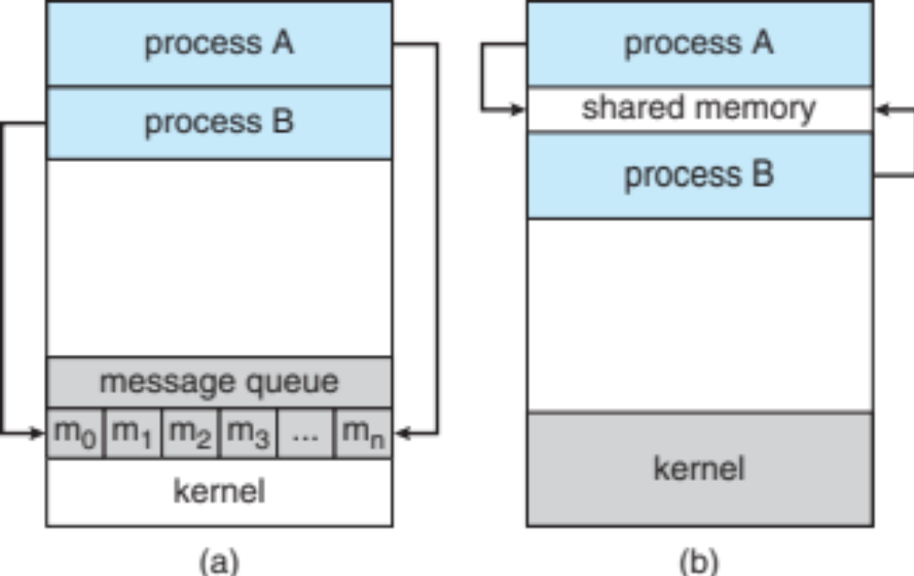
Two Models of IPC
(a) Message passing
(b) Shared memory

Slide 37
Shared Memory:
Producer-Consumer Problem
Paradigm for cooperating processes, producer process produces information that is consumed by a consumer process
  unbounded-buffer places no practical limit on the size of the buffer
  bounded-buffer assumes that there is a fixed buffer size
Will be detailed out in Chapter 6 – Synchronization.

Slide 38
Bounded-Buffer – Shared-Memory Solution
Details in Chap. 6 !
Shared data
      #define BUFFER_SIZE 10
      typedef struct {
      . . .
      } item;
      item buffer[BUFFER_SIZE];
      int in = 0;
      int out = 0;
Solution is correct, but can only use BUFFER_SIZE-1 elements

Slide 39
Bounded-Buffer – Producer
Details in Chap. 6 !
item next produced;
while (true) {
/* produce an item in next produced */
while (((in + 1) % BUFFER SIZE) == out)
; /* do nothing */
buffer[in] = next produced;
in = (in + 1) % BUFFER SIZE;
}

Slide 40
Bounded Buffer – Consumer
Details in Chap. 6 !
item next consumed;
while (true) {
while (in == out)
; /* do nothing */
next consumed = buffer[out];
out = (out + 1) % BUFFER SIZE;
/* consume the item in next consumed */
}

Slide 41
IPC – Message Passing
Mechanism for processes to communicate and to synchronize their actions
Message system – processes communicate with each other without resorting to shared variables
IPC facility provides two operations:
  send(message) – message size fixed or variable
  receive(message)

Slide 42
IPC – Message Passing
If P and Q wish to communicate, they need to:
  establish a communication link between them
  exchange messages via send/receive
Implementation of communication link
  physical (e.g., shared memory, hardware bus)
  logical (e.g., direct or indirect, synchronous or asynchronous, automatic or explicit buffering)

Slide 43
Direct Communication
Processes must name each other explicitly:
  send (P, message) – send a message to process P
  receive(Q, message) – receive a message from process Q
Properties of communication link
  Links are established automatically
  A link is associated with exactly one pair of communicating processes
  Between each pair there exists exactly one link
  The link may be unidirectional, but is usually bi-directional

Slide 44
Indirect Communication
Messages are directed and received from mailboxes (also referred to as ports)
  Each mailbox has a unique id
  Processes can communicate only if they share a mailbox
Properties of communication link
  Link established only if processes share a common mailbox
  A link may be associated with many processes
  Each pair of processes may share several communication links
  Link may be unidirectional or bi-directional

Slide 45
Indirect Communication
Operations
  create a new mailbox
  send and receive messages through mailbox
  destroy a mailbox
Primitives are defined as:
send(A, message) – send a message to mailbox A
receive(A, message) – receive a message from mailbox A

Slide 46
Indirect Communication
Mailbox sharing
  P₁, P₂, and P₃ share mailbox A
  P₁, sends; P₂ and P₃ receive
  Who gets the message?
Solutions
  Allow a link to be associated with at most two processes
  Allow only one process at a time to execute a receive operation
  Allow the system to select arbitrarily the receiver. Sender is notified who the receiver was.

Slide 47
Synchronization
Message passing may be either blocking or non-blocking
Blocking is considered synchronous
  Blocking send has the sender block until the message is received
  Blocking receive has the receiver block until a message is available
Non-blocking is considered asynchronous
  Non-blocking send has the sender send the message and continue
  Non-blocking receive has the receiver receive a valid message or null
}

Slide 48
EXERCISE
From Silberchatz, Operating System Concepts Chapter 3 Exercises
Odd number Matric card – 3.1, 3.3, 3.5
Even number Matric card – 3.2, 3.4, 3.9
Due date: Submit to e-learning 5 days after the end of the lecture.

Slide 49
End of Chapter 3

